Slide 1
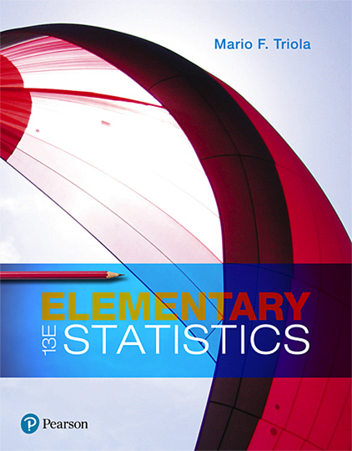
Elementary Statistics
Thirteenth Edition
Chapter 3
Describing, Exploring, and Comparing Data
Copyright © 2018, 2014, 2012 Pearson Education, Inc. All Rights Reserved

Slide 2
Describing, Exploring, and Comparing Data
3-1 Measures of Center
3-2 Measures of Variation
3-3 Measures of Relative Standing and Boxplots

Slide 3
Key Concept
Variation is the single most important topic in statistics, so this is the single most important section in this book. This section presents three important measures of variation: range, standard deviation, and variance.
These statistics are numbers, but our focus is not just computing those numbers but developing the ability to interpret and understand them.

Slide 4
Round-off Rule for Measures of Variation
Round-off Rule for Measures of Variation
When rounding the value of a measure of variation, carry one more decimal place than is present in the original set of data.

Slide 5
Range
Range
The range of a set of data values is the difference between the maximum data value and the minimum data value.
Range = (maximum data value) − (minimum data value)

Slide 6
Important Property of Range
The range uses only the maximum and the minimum data values, so it is very sensitive to extreme values. The range is not resistant.
Because the range uses only the maximum and minimum values, it does not take every value into account and therefore does not truly reflect the variation among all of the data values.

Slide 7
Example: Range
Find the range of these Verizon data speeds (Mbps): 38.5, 55.6, 22.4, 14.1, 23.1.
Solution
Range = (maximum value) − (minimum value)
= 55.6 − 14.1 = 41.50 Mbps

Slide 8
Standard Deviation of a Sample (1 of 2)
Standard Deviation
The standard deviation of a set of sample values, denoted by s, is a measure of how much data values deviate away from the mean.
Notation
s = sample standard deviation
σ = population standard deviation

Slide 9
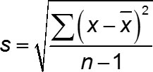
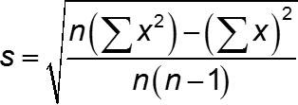
Standard Deviation of a Sample (2 of 2)
Standard Deviation
sample standard deviation
Shortcut formula for sample standard deviation (used by calculators and software)

Slide 10
Important Properties of Standard Deviation (1 of 2)
The standard deviation is a measure of how much data values deviate away from the mean.
The value of the standard deviation s is never negative. It is zero only when all of the data values are exactly the same.
Larger values of s indicate greater amounts of variation.

Slide 11
Important Properties of Standard Deviation (2 of 2)
The standard deviation s can increase dramatically with one or more outliers.
The units of the standard deviation s (such as minutes, feet, pounds) are the same as the units of the original data values.
The sample standard deviation s is a biased estimator of the population standard deviation σ, which means that values of the sample standard deviation s do not center around the value of σ.

Slide 12
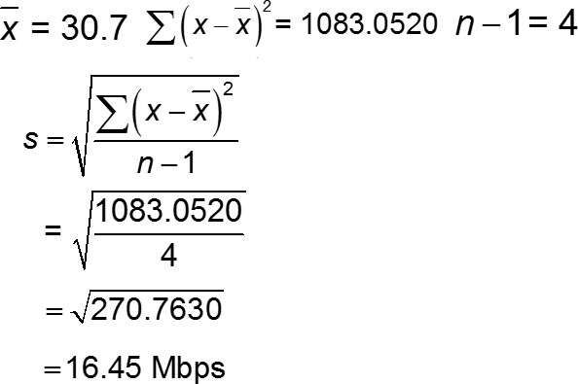
Example: Calculating Standard Deviation
Use sample standard deviation formula to find the standard deviation of these Verizon data speed times (in Mbps): 38.5, 55.6, 22.4, 14.1, 23.1.
Solution

Slide 13
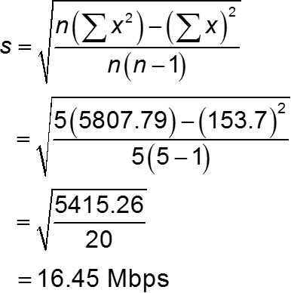
Example: Calculating Standard Deviation Using Shortcut Formula
Find the standard deviation of the Verizon data speeds (Mbps) of 38.5, 55.6, 22.4, 14.1, 23.1
Solution

Slide 14
Range Rule of Thumb for Understanding Standard Deviation
Range Rule of Thumb
The range rule of thumb is a crude but simple tool for understanding and interpreting standard deviation. The vast majority (such as 95%) of sample values lie within 2 standard deviations of the mean.

Slide 15
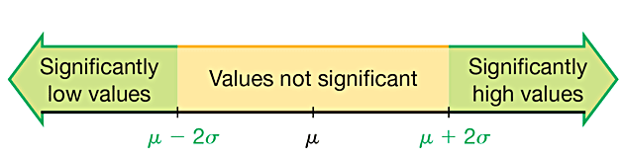
Range Rule of Thumb for Identifying Significant Values
Significantly low values are µ − 2σ or lower.
Significantly high values are µ + 2σ or higher.
Values not significant are between (µ − 2σ ) and (µ + 2σ).

Slide 16

Range Rule of Thumb for Estimating a Value of the Standard Deviation s
Range Rule of Thumb for Estimating a Value of the Standard Deviation
To roughly estimate the standard deviation from a collection of known sample data, use

Slide 17
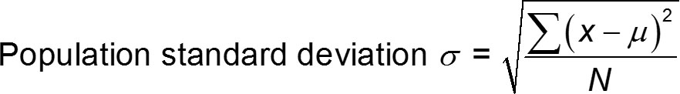
Standard Deviation of a Population
Standard Deviation of a Population
A different formula is used to calculate the standard deviation σ of a population: Instead of dividing by n − 1 for a sample, we divide by the population size N.

Slide 18
Variance of a Sample and a Population
Variance
The variance of a set of values is a measure of variation equal to the square of the standard deviation.
Sample variance: s² = square of the standard deviation s.
Population variance: σ² = square of the population standard deviation σ.

Slide 19
Notation Summary
s = sample standard deviation
s² = sample variance
σ = population standard deviation
σ² = population variance

Slide 20
Important Properties of Variance
The units of the variance are the squares of the units of the original data values.
The value of the variance can increase dramatically with the inclusion of outliers. (The variance is not resistant.)
The value of the variance is never negative. It is zero only when all of the data values are the same number.
The sample variance s² is an unbiased estimator of the population variance σ².

Slide 21
Why Divide by (n – 1)?
There are only n − 1 values that can assigned without constraint. With a given mean, we can use any numbers for the first n − 1 values, but the last value will then be automatically determined.
With division by n − 1, sample variances s² tend to center around the value of the population variance σ²; with division by n, sample variances s² tend to underestimate the value of the population variance σ².

Slide 22
Empirical Rule for Data with a Bell-Shaped Distribution
The empirical rule states that for data sets having a distribution that is approximately bell-shaped, the following properties apply.
About 68% of all values fall within 1 standard deviation of the mean.
About 95% of all values fall within 2 standard deviations of the mean.
About 99.7% of all values fall within 3 standard deviations of the mean.

Slide 23
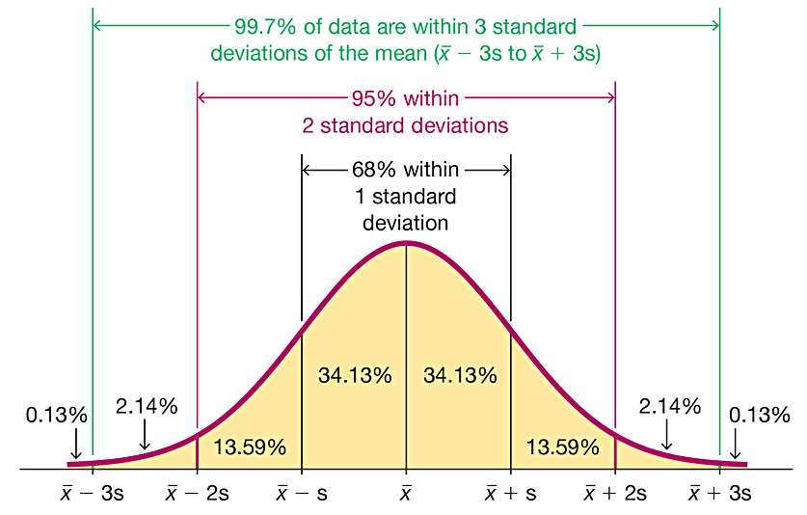
The Empirical Rule

Slide 24
Example: The Empirical Rule (1 of 2)
IQ scores have a bell-shaped distribution with a mean of 100 and a standard deviation of 15. What percentage of IQ scores are between 70 and 130?

Slide 25
Example: The Empirical Rule (2 of 2)
Solution
The key is to recognize that 70 and 130 are each exactly 2 standard deviations away from the mean of 100.
2 standard deviations = 2s = 2(15) = 30
2 standard deviations from the mean is
100 − 30 = 70
or 100 + 30 = 130
About 95% of all IQ scores are between 70 and 130.

Slide 26
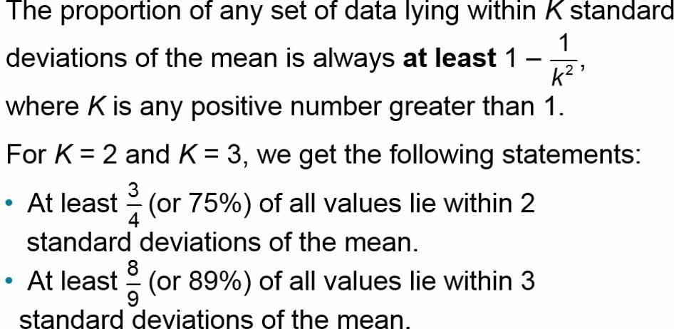
Chebyshev’s Theorem

Slide 27
Example: Chebyshev’s Theorem (1 of 2)
IQ scores have a mean of 100 and a standard deviation of 15. What can we conclude from Chebyshev’s theorem?

Slide 28
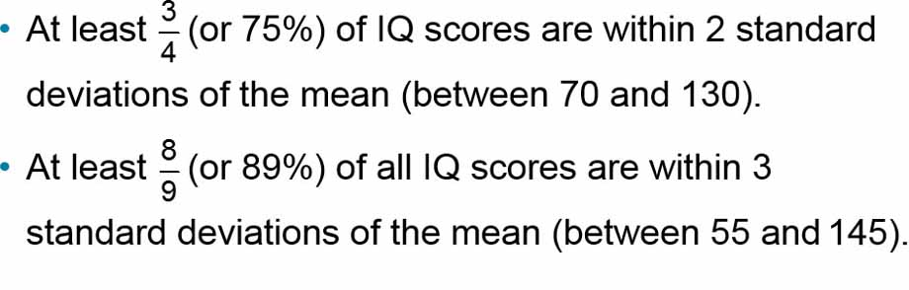
Example: Chebyshev’s Theorem (2 of 2)
Solution
Applying Chebyshev’s theorem with a mean of 100 and a standard deviation of 15, we can reach the following conclusions:

Slide 29
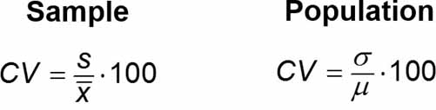
Comparing Variation in Different Samples or Populations
Coefficient of Variation
The coefficient of variation (or CV) for a set of nonnegative sample or population data, expressed as a percent, describes the standard deviation relative to the mean, and is given by the following:

Slide 30
Round-off Rule for the Coefficient of Variation
Round the coefficient of variation to one decimal place (such as 25.3%).

Slide 31
Biased and Unbiased Estimators
The sample standard deviation s is a biased estimator of the population standard deviation s, which means that values of the sample standard deviation s do not tend to center around the value of the population standard deviation σ.
The sample variance s² is an unbiased estimator of the population variance σ², which means that values of s² tend to center around the value of σ² instead of systematically tending to overestimate or underestimate σ².

